Slide 1
Conjoint analysis: Statistical method – Linear regression

Slide 2
Introduction: How?
A traditional conjoint analysis is really just a multiple regression problem.
The respondent’s ratings for the product concepts form the dependent variable.
The characteristics of the product (the attribute levels) are the independent (predictor) variables.
The estimated betas associated with the independent variables are the utilities (preference scores) for the levels.
The R-Square for the regression characterizes the internal consistency of the respondent.

Slide 3
Example
Consumer choice process for a cell phone purchase.
Three attributes – Brand, Battery size, and the Camera resolution.
We have three brands to choose from; two options for battery, and three choices for the camera resolution.
We assume that this is a full-factorial design. Therefore, the respondent (customer, buyer) is shown all the 18 combinations available. And they provide a preference rank for each of these combinations.
See the Excel file…

Slide 4
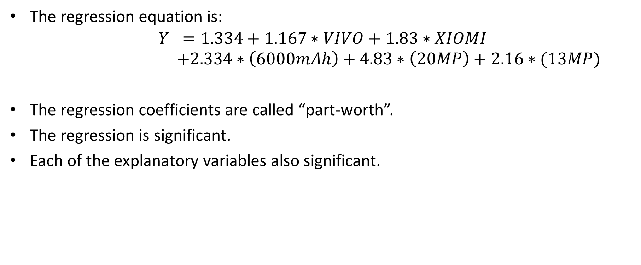
Example: Regression statistics
The regression equation is:
$$Y =1.334+1.167∗VIVO+1.83∗XIOMI$$
$$+2.334∗\left(6000mAh\right)+4.83∗\left(20MP\right)+2.16∗(13MP)$$
The regression coefficients are called “part-worth”.
The regression is significant.
Each of the explanatory variables also significant.

Slide 5
Partworths
These are the level utilities for the attributes.
The total worth of the product (option) is calculated from multiple attributes and multiple levels of attributes together.
Utility values for the separate parts of the product (assigned to the attributes) are the part worths.
Partworth for each level of each attribute:
Camera resolution
8 MP | 0
13 MP | 2.167
20 MP | 4.834
Brand/Manufacturer
Samsung | 0
Vivo | 1.167
Xiomi | 1.834
Battery
4500 mAh | 0
6000 mAh | 2.334

Slide 6
Importance of each attribute
Attribute | Partworth range
Brand | 1.834 – 0 = 1.834
Battery | 2.334 – 0 = 2.334
Camera | 4.834 – 0 = 4.834
Total of ranges = 1.834 + 2.334 + 4.834 = 9.002
Attribute | Importance
Brand | 1.834/9 = 20.37%
Battery | 2.334/9 = 25.92%
Camera | 4.834/9 = 53.7%

